Slide 1

www.provendwconsultant.com

Slide 2
PL/SQL
NAME:
SRIKANTH KESHAVENA
EMAIL ID:
srikanth@provendw.co.in
www.provendwconsultant.com

Slide 3
AGENDA
INTRODUCTION ABOUT PL/SQL
ADVANTAGES OF PL/SQL
VARIABLES AND DATA TYPES
CONDITIONAL STATEMENTS
ITERATIVE STATEMENTS
CURSORS
www.provendwconsultant.com

Slide 4
AGENDA
RECORD TYPES
EXCEPTIONS
PROCEDURE
FUNCTION
PACKAGES
TRIGGERS
www.provendwconsultant.com

Slide 5
INTRODUNTION OF PL/SQL
Pl/sql is a procedural language to extention of sql
A set of SQL and PL/SQL statements are grouped together as a unit called BLOCK to solve a specific problem or to perform set of actions.
www.provendwconsultant.com

Slide 6
A PL/SQL Block consists of three sections:
The Declaration section (Optional).
The Execution section (Mandatory).
The Exception (or Error) Handling section (Optional).
www.provendwconsultant.com

Slide 7
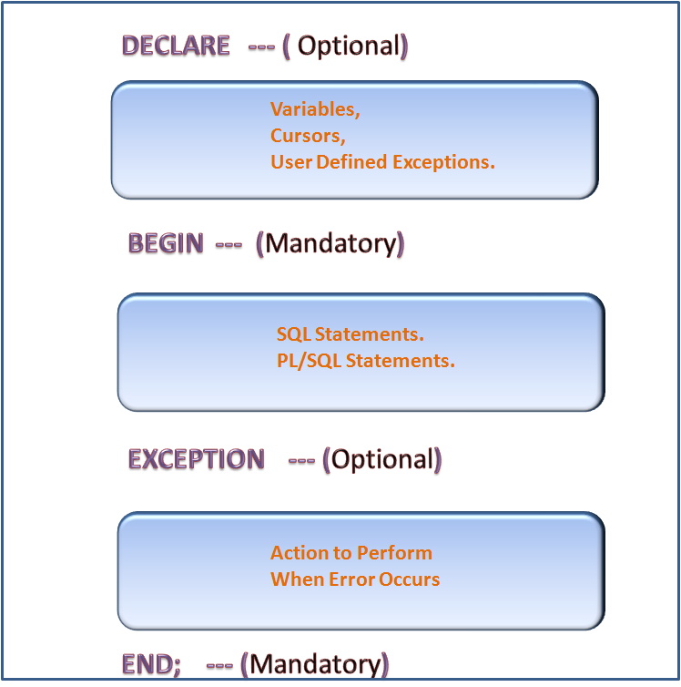
ANONYMOUS BLOCKS:
www.provendwconsultant.com`

Slide 8

BASIC PROGRAM
DECLARE
myvariable varchar2(100);
BEGIN
myvariable := 'provendw';
DBMS_OUTPUT.PUT_LINE('Welcome to ---'||myvariable );
END;
www.provendwconsultant.com

Slide 9
ADVANTAGES OF PL/SQL
Integration with SQL
Better Performance
Full Portability
Tight Security
www.provendwconsultant.com

Slide 10
Tight Integration with SQL:
PL/SQL allows us to use SQL data manipulation, cursor control, and transaction control commands, as well as all the SQL functions, operators, and pseudocolumns.
This extensive SQL support allows us to manipulate Oracle data flexibly and safely.
PL/SQL fully supports SQL datatypes, reducing the need to convert data which is passed between our applications and the database.
PL/SQL
SQL
www.provendwconsultant.com

Slide 11
Better Performance:
A single SQL statement causes two trips on the network
If multiple SELECT statements are issued, network traffic increases significantly very fast.
Hence PL/SQL overcomes this problem because entire block of statements can be sent to Oracle at one time, so therefore it reduces the network traffic between the Database and the Application
IF,IF ELSE,ELSIF….
LOOP,FORLOOP
User application
Database
www.provendwconsultant.com

Slide 12

Full Portability:
Programs written in PL/SQL can run in any Operating System where ever our oracle Database got installed.
With PL/SQL we can write portable programs which we can reuse in different environments.
www.provendwconsultant.com

Slide 13

Tight Security:
While moving PL/SQL stored procedures from client to the server we can protect out programs from network tampering, and also we can restrict to the access of programs.
Triggers written in PL/SQL can obey the business rules for the changes which we made in database
www.provendwconsultant.com

Slide 14
What is a Variable ?
Variables are like placeholders or temporary storage locations in database, we use them to store/manipulate data at the time of PL/SQL block execution.
www.provendwconsultant.com

Slide 15
PL/SQL DATA TYPES
SCALAR DATA TYPE
REFERENCE DATA TYPE
COMPOSITE DATA TYPE
LOB DATA TYPE
www.provendwconsultant.com

Slide 16
scalar DATA TYPE
Scalar datatypes are the same data types that we use in SQL. These can be used in PL/SQL to define variables.
Scalar Data Type holds a single value.
Scalar Data Types supports Boolean variables.
Examples for Scalar Data Types:-
DECLARE
name VARCHAR2(10):=’SMITH’;
empno NUMBER;
hiredate DATE;
---
www.provendwconsultant.com

Slide 17

REFERENCE DATA TYPE
We use reference datatypes when we wanted to refer to the type of some database column.
There are two types of Reference Types :
%TYPE
%ROWTYPE
www.provendwconsultant.com

Slide 18
%TYPE – ‘%TYPE’ is used to copy the data type of a column in a database table.
%ROWTYPE – ‘ROW%TYPE’ is used to copy the structure of entire record in a database table. We will discussing more about %ROWTYPE in Record using %ROWTYPE lesson
www.provendwconsultant.com

Slide 19
EXAMPLE:
Syntax for %TYPE :-
DECLARE
<variable name> <table name>.<column name>%TYPE;
---
---
Example for %TYPE :-
DECLARE
v_deptno dept.deptno%TYPE;
v_dname dept.dname%TYPE;
BEGIN
SELECT deptno, dname
INTO v_deptno, v_dname
FROM dept
WHERE deptno = 10;
DBMS_OUTPUT.PUT_LINE (v_deptno || ' '|| v_dname);
END;
www.provendwconsultant.com

Slide 20
COMPOSITE DATA TYPE
Composite data types are part of advanced PL/SQL, we will be learning them in coming chapters.
We use LOB datatypes when we wanted to store large object information like images,vidoes…..etc
LOB DATA TYPE
www.provendwconsultant.com

Slide 21
Different LOB Data Types:
BLOB
Binary Large Object – column or variable of type BLOB can store up to 4GB of binary data in each record.
CLOB
Character Large Object – column or variable of type CLOB can store up to 4GB of character data in each record.
www.provendwconsultant.com

Slide 22
CONSTANT VARIABLE
A CONSTANT VARIABLE is a variable that is defined in the declaration section of the block
which remains unchanged throughout the program. To define a CONSTANT variable we need to explicitly specify a keyword called ‘CONSTANT’ when declaring the variable.
DECLARE
<variable name> CONSTANT <data type> := <value>;
---
---
www.provendwconsultant.com

Slide 23
EXAMPLE:
DECLARE
/* Declaring constant variable */
v_tax CONSTANT number (3):= 5;
BEGIN
v_tax := 10;
/* System will raise an error as we are trying to assign a different value other than constant */
DBMS_OUTPUT.PUT_LINE (v_tax);
END;
Output:
PLS-00363: expression 'V_TAX' cannot be used as an assignment target.
www.provendwconsultant.com

Slide 24
CONDITIONAL STATEMENTS
A conditional statement refers to the ability to process a portion of code depending on whether certain criteria is met or not.
Different types of conditional statements.
IF Statement.
IF-ELSE.
NESTEDIF.
ELSEIF.
CASE Statement.
www.provendwconsultant.com
Notes:
i.e., In a program, if a condition is met then we wanted to execute certain portion of code and if condition is
not met then we wanted to execute different portion of code.

Slide 25
IF STATEMENT:
IF statement allows us to execute sequence number of statements based
on condition.
This is the most basic conditional evaluation statement
i.e.,
IF Condition is met, THEN do Something
IF Condition is not met, Skip the code that follows till END IF.
General syntax:
IF <Condition> THEN
---------
--------- (Executable statements)
---------
END IF;
www.provendwconsultant.com

Slide 26
Example:
DECLARE
a NUMBER := 2;
b NUMBER := 2;
BEGIN
IF a=b THEN
DBMS_OUTPUT.PUT_LINE (‘XXXXXX');
END IF;
DBMS_OUTPUT.PUT_LINE (‘YYYYYY');
END;
www.provendwconsultant.com

Slide 27
IF-ELSE:
IF
CONDITION
TRUE
FALSE
THEN
(STATEMNTS)
ELSE
(STATEMNTS)
www.provendwconsultant.com

Slide 28
Example:
DECLARE
a NUMBER := 2;
b NUMBER := 3;
BEGIN
IF a=b THEN
DBMS_OUTPUT.PUT_LINE ('Welcome to PROVEN DW');
ELSE
DBMS_OUTPUT.PUT_LINE (‘BYE PROVEN DW');
END IF;
END;
www.provendwconsultant.com

Slide 29
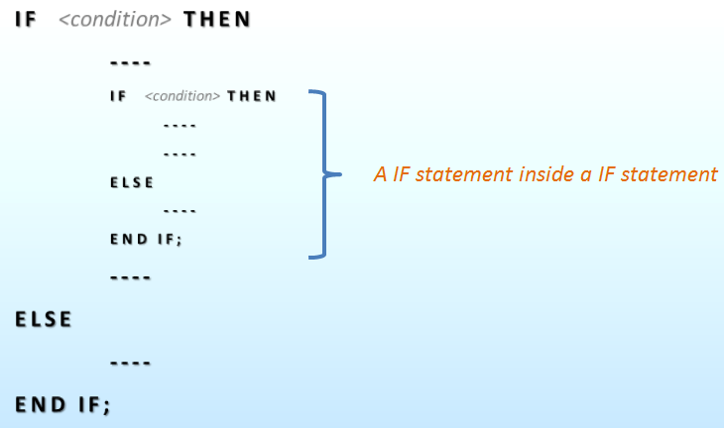
NESTED IF:
Calling conditional IF statement one inside another is called as Nested IF statement
In Nested IF, result of the first IF statement will decide the execution of child IF statements
Each nested IF statement must be terminated with a corresponding END IF clause.
Syntax:
www.provendwconsultant.com

Slide 30
Example:
DECLARE
v_deptno NUMBER (2) ;
v_name VARCHAR2 (100) := 'SALES' ;
BEGIN
SELECT deptno
INTO v_deptno
FROM dept
WHERE dname = v_name;
DBMS_OUTPUT.PUT_LINE ('Department Number fetched is - '||v_deptno);
IF (v_deptno > 20 ) THEN
DBMS_OUTPUT.PUT_LINE ('Department Number is greater than 20');
IF (v_deptno = 30) THEN
DBMS_OUTPUT.PUT_LINE ('We are in Department Number 30');
ELSE
www.provendwconsultant.com

Slide 31
IF (v_deptno = 40) THEN
DBMS_OUTPUT.PUT_LINE ('We are in Department Number 40');
END IF;
END IF;
ELSE
DBMS_OUTPUT.PUT_LINE ('Department Number is less than or equal to 20');
IF (v_deptno = 20) THEN
DBMS_OUTPUT.PUT_LINE ('We are in Department Number 20');
ELSE
IF (v_deptno = 10) THEN
DBMS_OUTPUT.PUT_LINE ('We are in Department Number 10');
END IF;
END IF;
END IF;
END
www.provendwconsultant.com

Slide 32
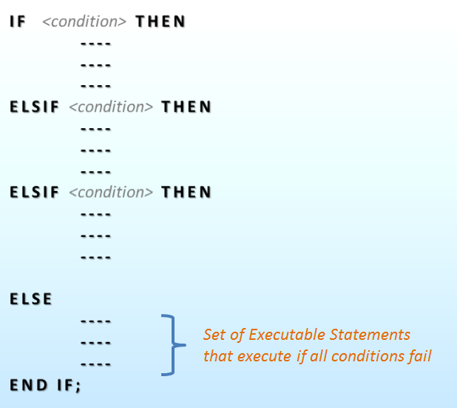
ELSIF:
ELSIF condition statement is very similar to NESTED IF, but in ELSIF we specify all IF statements in a sequential way using ‘ELSIF’ keyword.
ELSIF statement is useful when we have multiple conditional statements to evaluate.
Syntax:
www.provendwconsultant.com

Slide 33
Example:
DECLARE
v_deptno NUMBER (2) ;
v_name VARCHAR2 (100) := 'SALES' ;
BEGIN
SELECT deptno
INTO v_deptno
FROM dept
WHERE dname = v_name;
DBMS_OUTPUT.PUT_LINE ('Department Number fetched is - '||v_deptno);
IF (v_deptno = 10)
THEN
DBMS_OUTPUT.PUT_LINE ('We are in Department Number 10');
ELSIF (v_deptno = 20)
THEN
DBMS_OUTPUT.PUT_LINE ('We are in Department Number 20');
www.provendwconsultant.com

Slide 34
ELSIF (v_deptno = 30)
THEN
DBMS_OUTPUT.PUT_LINE ('We are in Department Number 30');
ELSIF (v_deptno = 40)
THEN
DBMS_OUTPUT.PUT_LINE ('We are in Department Number 40');
ELSE
DBMS_OUTPUT.PUT_LINE ('Sorry! No such department exists');
END IF;
END;
www.provendwconsultant.com

Slide 35
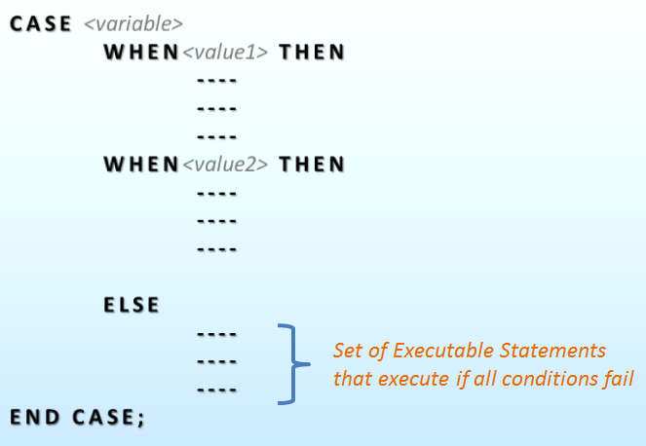
CASE Statement:
It is an another type of conditional statement which allows us to execute a sequence of statements based on a selector.
A selector can be anything such as variable, function, or expression that the CASE statement evaluates to some value.
The selector in CASE statement is followed by one or more WHEN clauses, which are checked sequentially.
Syntax:
www.provendwconsultant.com

Slide 36
Example:
DECLARE
v_deptno NUMBER (2):=20;
v_dname VARCHAR2 (100);
BEGIN
SELECT dname
INTO v_dname
FROM dept
WHERE deptno = v_deptno;
CASE v_deptno
WHEN 10 THEN
DBMS_OUTPUT.PUT_LINE ('The Department Name of Deptno is: '||v_dname);
WHEN 20 THEN
DBMS_OUTPUT.PUT_LINE ('The Department Name of Deptno is: '||v_dname);
www.provendwconsultant.com

Slide 37
WHEN 30 THEN
DBMS_OUTPUT.PUT_LINE ('The Department Name of Deptno is: '||v_dname);
WHEN 40 THEN
DBMS_OUTPUT.PUT_LINE ('The Department Name of Deptno is: '||v_dname);
ELSE
DBMS_OUTPUT.PUT_LINE ('Sorry ! No Such Records Exists');
END CASE;
END;
www.provendwconsultant.com

Slide 38

iterative control Statements:
An iterative control Statements are used when we wanted to execute same set of statements for a specified number of times.
i.e., it will execute a set of statements repeatedly until a specified condition is TRUE.
Types of iterative control statements:
Simple loop.
While loop.
Numeric for loop.
Cursor for loop.
www.provendwconsultant.com

Slide 39
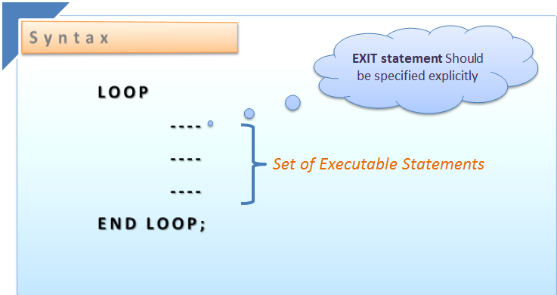
Simple loop:
It is an infinite loop task A Simple Loop is used when we wanted to execute the set of statements at least once before the loop terminates.
www.provendwconsultant.com

Slide 40
Standard steps to be followed while using simple loop: 1) Initialize a variable before the loop begins. 2) Increment the variable in the loop. 3) EXIT WHEN statement is used to exit from the Loop.
To break the simple loop:
Syntax:-
EXIT WHEN <condition>;
IF <condition> THEN
EXIT;
END IF;
www.provendwconsultant.com

Slide 41
Example:
DECLARE
v_num number (10):=0;
BEGIN
DBMS_OUTPUT.put_line ('the numbers are--');
LOOP
v_num:=v_num+1;
DBMS_OUTPUT.PUT_LINE(v_num);
EXIT WHEN (v_num=10);
END LOOP;
END;
www.provendwconsultant.com

Slide 42
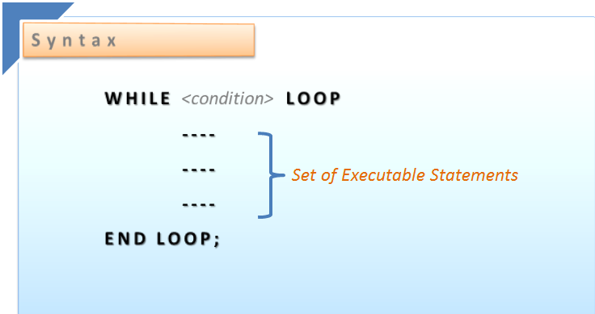
While loop statement:
It is used when we want to execute set of statements untill the condition is true.
The execution of statements continues until the condition is false.
www.provendwconsultant.com

Slide 43
Example:
Example:-
DECLARE
v_num number (10):=0;
BEGIN
WHILE (v_num <=10) loop
DBMS_OUTPUT.put_line (v_num);
v_num:= v_num +1;
END LOOP;
END;
www.provendwconsultant.com

Slide 44
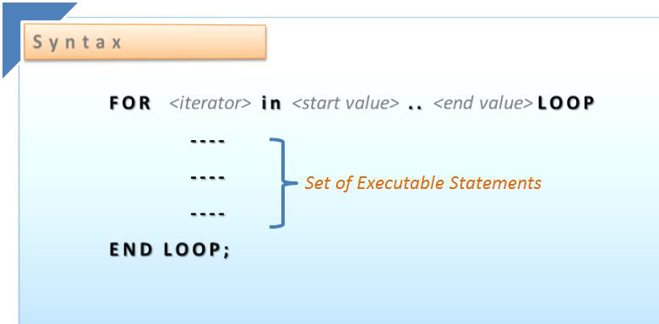
For loop:
For loop statements is used when we want to executes set of statements for a specific number of times.
www.provendwconsultant.com

Slide 45
Example:
BEGIN
DBMS_OUTPUT.put_line (' The Numbers Are');
DBMS_OUTPUT.put_line ('-------------------------');
FOR v_num IN 1..10
LOOP
DBMS_OUTPUT.put_line (v_num);
END LOOP;
END;
www.provendwconsultant.com

Slide 46
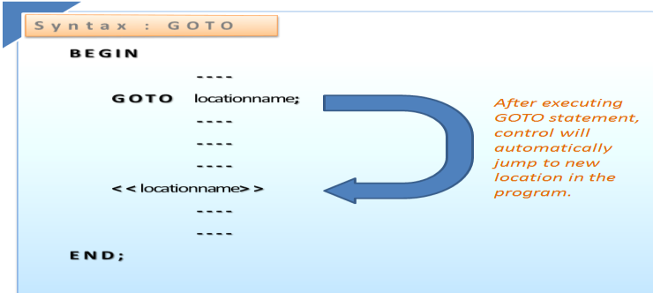
GOTO and LABELS:
GOTO statement is used when we want to skip the specific set of statements for execution.
www.provendwconsultant.com

Slide 47

Example:
BEGIN
FOR v_num IN 1..5
LOOP
DBMS_OUTPUT.put_line (v_num);
IF v_num = 3
THEN
GOTO exit_loop;
END IF;
END LOOP;
<<exit_loop>>
DBMS_OUTPUT.put_line (' End of program');
END;
www.provendwconsultant.com

Slide 48
Restrictions for using GOTO:
We cannot use GOTO statement where ever we want in PLSQL code, there are several restrictions defined for the usage as GOTO jumps the program control from one place to another.
It is illegal to branch into an inner block, loop.
At least one executable statement must follow.
www.provendwconsultant.com

Slide 49
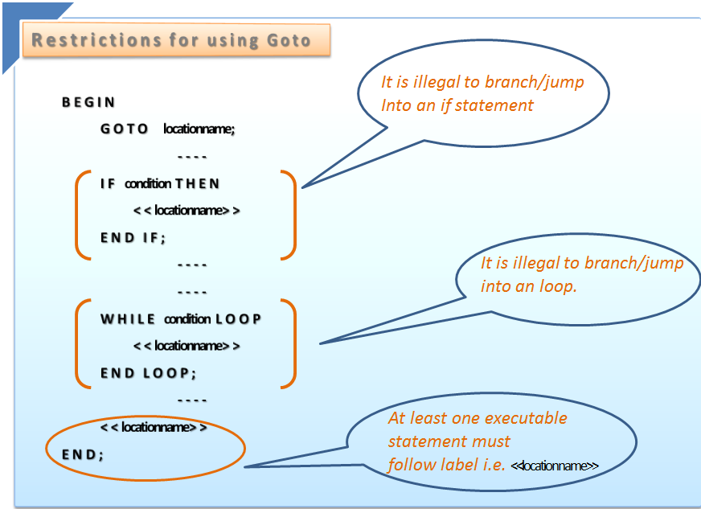
Restrictions for using GOTO:
www.provendwconsultant.com

Slide 50
Example:
BEGIN
FOR v_num IN 1..5
LOOP
DBMS_OUTPUT.put_line (' v_num = ' || v_num);
IF v_num = 4
THEN
GOTO exit_loop;
END IF;
END LOOP;
<<exit_loop>>
DBMS_OUTPUT.put_line (' End of program');
END;
www.provendwconsultant.com

Slide 51

QUESTIONS:
GOTO STATEMENT CANNOT SKIP STATEMENT IN ANY PART OF THE PROGRAM?
TRUE
FALSE
HOW MANY VALUES SCALAR DATA TYPE CAN HOLD?
SINGLE VALUE
MULTIPLE VALUES

Slide 52
IN WHICH BLOCK WE CAN ASSIGN THE VALUE FOR CONSTANT VARIABLE?
DECLARE BLOCK
EXECUTION BLOCK
BOTH A & B
WHICH DATA TYPE WILL GIVE TOTAL TABLE STRUCTURE?
COMPOSITE DATA TYPE
REFERENCE DATA TYPE
BOTH A & B

Slide 53
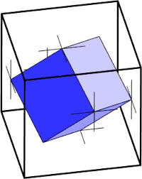
CURSOR
CURSOR is a handle or pointer to the context area. Using a cursor, the PL/SQL program can control the context area.
There are two types of cursors in PL/SQL:
Implicit Cursors
Explicit Cursors
www.provendwconsultant.com

Slide 54
IMPLICIT CURSOR
Implicit Cursors:
Implicit cursor is automatically created by the system
whenever program executes DML statements like
DELETE, INSERT, UPDATE statements.
www.provendwconsultant.com

Slide 55
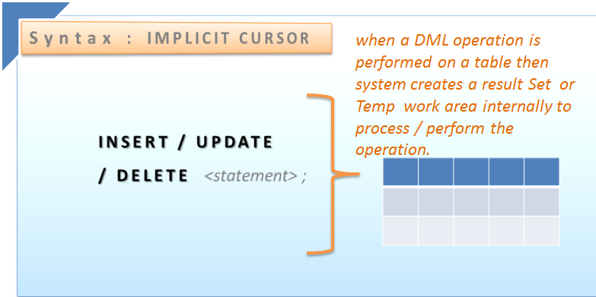
IMPLICIT CURSOR
www.provendwconsultant.com

Slide 56
EXAMPLE:
DECLARE
V_ENAME VARCHAR2(10);
V_JOB VARCHAR2(10):='SALES';
BEGIN
UPDATE EMP SET SAL=SAL+77 WHERE DEPTNO=(SELECT DEPTNO FROM EMP WHERE JOB='SALES');
www.provendwconsultant.com

Slide 57
IF SQL%FOUND THEN
DBMS_OUTPUT.PUT_LINE(SQL%ROWCOUNT||' '||'ROW(s) ARE UPDATED');
ELSE
DBMS_OUTPUT.PUT_LINE('NO RECORDS ARE UPDATED');
END IF;
END;
/
www.provendwconsultant.com

Slide 58

EXPLICIT CURSOR
Explicit Cursors:
Explicit cursor should be explicitly defined in the declaration section of the PL/SQL Block.
Explicit cursor is created on a SELECT Statement which returns more than one row from the database.
www.provendwconsultant.com

Slide 59
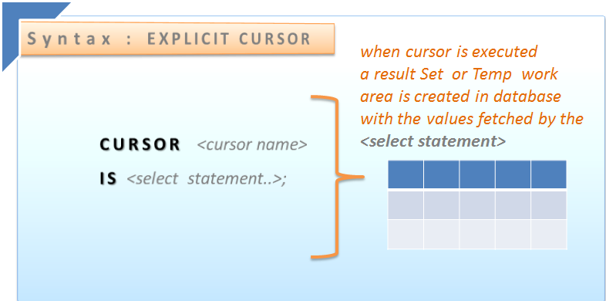
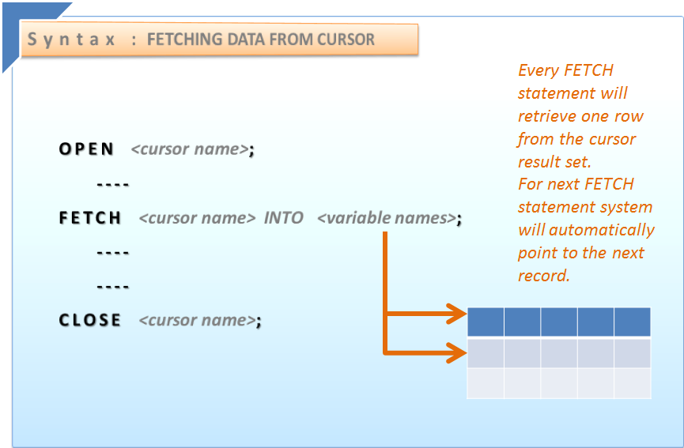
EXPLICIT CURSOR
www.provendwconsultant.com

Slide 60
EXAMPLE:
DECLARE
CURSOR CUR_EMP IS SELECT ENAME,SAL,COMM FROM EMP ORDER BY DEPTNO;
V_ENAME VARCHAR2(10);
V_SAL NUMBER(20);
V_COMM NUMBER(9);
www.provendwconsultant.com

Slide 61
BEGIN
OPEN CUR_EMP;
IF CUR_EMP%ISOPEN THEN
DBMS_OUTPUT.PUT_LINE('THE RECORDS ARE TO BE FETCH');
END IF;
www.provendwconsultant.com

Slide 62
LOOP
FETCH CUR_EMP INTO V_ENAME,V_SAL,V_COMM;
EXIT WHEN CUR_EMP%NOTFOUND;
DBMS_OUTPUT.PUT_LINE(CUR_EMP%ROWCOUNT||' '||V_ENAME);
END LOOP;
CLOSE CUR_EMP;
END;
/
www.provendwconsultant.com

Slide 63
Record type:
Records are called composite data types, as record is a combination of multiple scalar data types like char,varchar2, number etc.
Each field in the PL/SQL record has its own name and data type.
A record can be created in two ways……
Using General syntax
Using %ROWTYPE
www.provendwconsultant.com

Slide 64
USING %ROWTYPE:
%ROWTYPE is used to refer to table structure. When we use %ROWTYPE system will internally create a record with the structure same as table record.
Syntax:
Emp_rec EMP%rowtype;
Individual record fields are referenced via dot notation
<record_name> <field_name>
www.provendwconsultant.com

Slide 65
Example:
END;
DECLARE
emp_rec emp%ROWTYPE;
BEGIN
emp_rec.ename := 'BLAKE';
SELECT * INTO emp_rec FROM emp
WHERE ename=emp_rec.ename;
DBMS_OUTPUT.put_line( emp_rec.empno ||' '|| emp_rec.ename ||' '|| emp_rec.sal||' '||emp_rec.job||' '||emp_rec. hiredate||' '||emp_rec.comm||' '||emp_rec. deptno);
www.provendwconsultant.com

Slide 66
USING GENERAL SYNTAX:
A Record can be visualized as a row data.
Example:
Declare
TYPE Emp_type IS RECORD
( empno NUMBER(5),
ename VARCHAR2(25),
job VARCHAR2 (25),
sal NUMBER(10)
hire_date DATE );
Emp_rec Emp_type;
www.provendwconsultant.com
Notes:
From the above statement, Emp_rec is created with type Emp_type;

Slide 67
Begin
Emp_rec.ename:=‘king’;
Select * into emp_rec
From emp
Where ename:=emp_rec.ename;
DBMS_OUTPUT.put_line( emp_rec.empno|| ' '||emp_rec.ename|| ' '|| emp_rec.sal||' '|| emp_rec.job);
End;
www.provendwconsultant.com

Slide 68
Errors
Two types of errors can be found in a program: compilation errors and runtime errors.
Runtime errors are known as Exceptions.
There is a special section in a PL/SQL block that handles the runtime errors.
This section is called the exception-handling section, and in it, runtime errors are referred to as exceptions.
The exception-handling section allows programmers to specify what actions should be taken when a specific exception occurs.

Slide 69

Why to handle the Exceptions….?
Whenever any exception raised in the execution block of Pl/sql we
have to handle that exception if not the program control comes out
of the execution block and execution stops abruptly and generates
system error message.

Slide 70
Exception Handling
In order to handle run time errors in the program, an exception handler must be added.
The exception-handling section has the following syntax:
EXCEPTION
WHEN EXCEPTION_NAME
THEN
ERROR-PROCESSING STATEMENTS;
The exception-handling section is placed after the executable section of the block.

Slide 71
Types of Exceptions:
Exceptions
Pre-defined
Non pre-defined
User defined

Slide 72
Pre-Defined Exceptions
These are defined by Oracle.
Activated by Oracle automatically.
Types:
No data found(ora-11403/100)
Value-Error(ora-01422)
Zero-divide(ora-01746)
Login-denied(ora-01017)

Slide 73
Example:
BEGIN
a number(2);
b number(2);
c number(2);
EXECUTION
a:=10;
b:=0;
c:=a/b;
EXCEPTION
WHEN ZERO_DIVIDE THEN
DBMS_OUTPUT.PUT_LINE(‘Denominator cannot be zero’);
WHEN OTHERS THEN
DBMS_OUTPUT.PUT_LINE(‘Please check your procedure');
END;

Slide 74
Non-Predefined Exceptions:
These are defined by Oracle.
Activated automatically by constraints
PRAGMA_EXCEPTION-INIT
Some of the system exceptions with error codes
between the range -20999 through -20000 don’t have
a exception name.
Syntax:
PRAGMA_EXCEPTION-INIT(exception-name,
oracle-error-number);

Slide 75
Example:
Declare
deptno_exists exception
PRAGMA_EXCEPTION-INIT(deptno_exists,-00001);
Begin
insert into dept values(123,’abc’);
Exception
When deptno_exists then
dbms_output.put_line(‘Deptno already exists with this’);
End;

Slide 76
User defined Exceptions:
These are defined by user.
A user-defined exception must be raised explicitly.
Activated by user using “RAISE” Statement.
Just like variables, exception has a type (EXCEPTION)
and scope

Slide 77
Raising Exception
DECLARE
exception_name EXCEPTION;
BEGIN
…
IF CONDITION
THEN
RAISE exception_name;
ELSE
…
END IF;
EXCEPTION
WHEN exception_name
THEN
ERROR-PROCESSING
STATEMENTS;
END;

Slide 78
Example
DECLARE
e_invalid_id EXCEPTION;
BEGIN
if EMPNO < 0
THEN
RAISE e_invalid_id
EXCEPTION
WHEN e_invalid_id
THEN
DBMS_OUTPUT.PUT_LINE ('An id cannot be negative');
END;

Slide 79

QUESTIONS:
IMPLICIT CURSOR GETS AUTOMATICALLY CREATED,WHEN WE USE______STATEMENT?
INSERT
SELECT
BOTH A&B
WHICH OF THE FOLLOWING ATTRIBUTE IS USED IN EXPLICIT CURSOR?
OPEN
%FOUND
BOTH A&B

Slide 80
CURSOR IS STORED IN DATA BASE LIKE DATABASE OBJECT?
TRUE
FALSE
RECORD ISN’T A COMBINATION OF MULTIPLE SCALAR DATA TYPES?
TRUE
FALSE

Slide 81
procedure
www.provendwconsultant.com

Slide 82

WHAT IS PROCEDURE?
Procedure is named plsql block
It has declaration block ,execution block and exception block
Procedure can be compiled and stored as schema object
www.provendwconsultant.com

Slide 83
Procedure promote reuseability and maintability
Using CREATE OR REPLACE command we can replace the procedure that already exists in the database with the same name
Procedure may or may not have return value
www.provendwconsultant.com

Slide 84
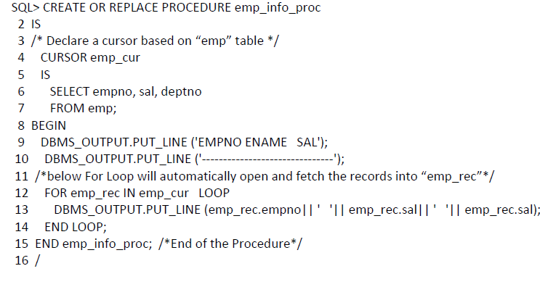
CREATING PROCEDURE:
www.provendwconsultant.com

Slide 85
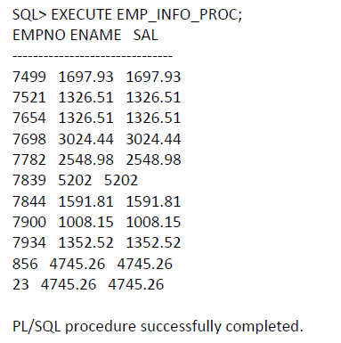

EXECUTING PROCEDURE:
www.provendwconsultant.com

Slide 86
SELECT text FROM user_source WHERE
name =‘<procedure_name>’;
ALTER PROCEDURE <procedure_name> COMPILE;
DROP PROCEDURE <procedure_name>;
www.provendwconsultant.com

Slide 87
function
www.provendwconsultant.com

Slide 88
WHAT IS FUNCTION?
Function is named plsql block
Function must return a value to the calling environment
Function can be stored in the database as a schema object for repeated execution
www.provendwconsultant.com

Slide 89
Function must have return clause in the header
Functions promotes reuseability and maintainability
Function can call through select statement
www.provendwconsultant.com

Slide 90
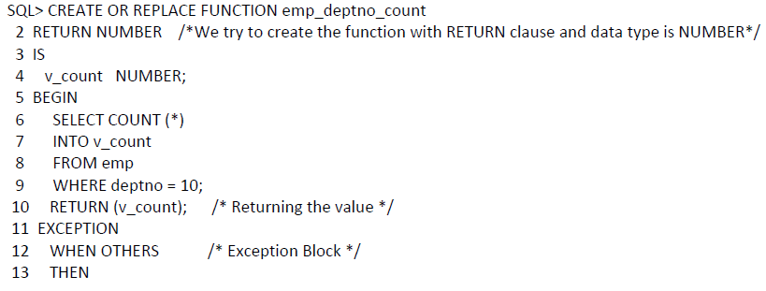
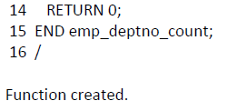
www.provendwconsultant.com

Slide 91
package
www.provendwconsultant.com

Slide 92

WHAT IS PACKAGE?
A package is PL/SQL construct that allows related objects to be stored together .
A package is a container for related objects.
Package is a method to handle all the required functions and procedures .
www.provendwconsultant.com

Slide 93

IMAGINARY DIAGRAM:
www.provendwconsultant.com

Slide 94
A well designed package is a logical grouping of objects such as
Functions
Procedures
Global Variables
Cursors.
www.provendwconsultant.com

Slide 95
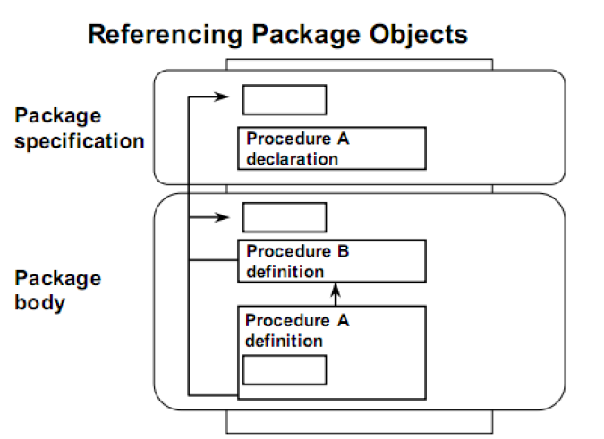
www.provendwconsultant.com

Slide 96
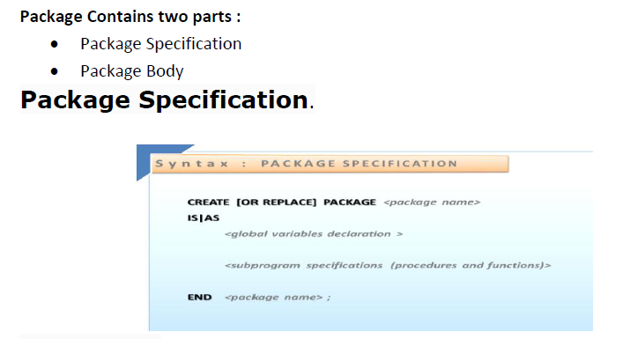
PACKAGE PARTS:
EXAMPLES\package body.txt
www.provendwconsultant.com

Slide 97
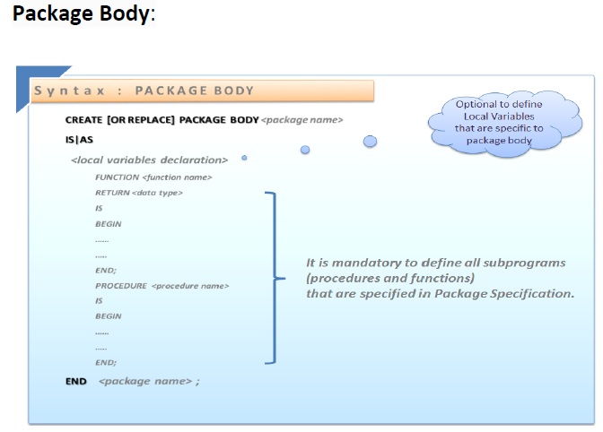
PACKAGE BODY:
EXAMPLES\package specification.txt
www.provendwconsultant.com

Slide 98

QUESTIONS:
IN WHICH OF THE FOLLOWING WE CAN USE RETURN ?
PROCEDURE
FUNCTION
BOTH A & B
WHICH ACTION WILL PERFORMED BY FUNCTION?
SPECIFIC ACTION
MULTIPLE ACTIONS

Slide 99
PROCEDURE CAN CALL BY SELECT STATEMENT?
TRUE
FALSE
FUNCTION CANNOT STORED IN DATA BASE?
TRUE
FALSE

Slide 100
What is a collection?
A collection is a composite type used to store
group/array of values of same data type.
Collections are mainly used to simplify the code.
There are three types of Collections that you can use
in PL/SQL.
PL/SQL Tables
Nested Tables
Variable Arrays.
www.provendwconsultant.com

Slide 101
PL/SQL table
Collection of elements with the same name and same data type.
A PL/SQL table has two columns, one is a PRIMARY KEY called the index, and the other holds the elements
The value column may have any data type
The key column must be binary_integer
www.provendwconsultant.com

Slide 102
Nested Tables
Nested Tables act as one-column database tables, which can store multiple rows of data from a database table.
Oracle does not store rows in a nested table in any particular order, but if you retrieve a table into a PL/SQL Collection, the rows are indexed consecutively starting at 1.
www.provendwconsultant.com

Slide 103
PL/SQL tables Vs Nested tables
Cannot be used to define the type of a database column
You cannot SELECT,
INSERT,UPDATE, or DELETE elements in a PL/SQL Table.
Elements can have negative indices
Increasing the number of elements is easy you just have to assign a new element.
Can be used to define the type of a database column
You can SELECT, INSERT, UPDATE, or DELETE elements in a Nested Table
Elements cannot have negative indices
To increase the number of elements, you must use the EXTEND method to increase the size of the Collection
www.provendwconsultant.com

Slide 104
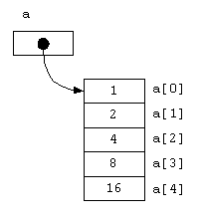
Variable Arrays
VARRAY, allow you to connect a single identifier with an entire Collection of data.
They are different from Nested tables in that you must specify an upper limit for the number of elements
A VARRAY is generally used when you must retrieve an entire Collection that is not very large.
www.provendwconsultant.com

Slide 105
PL/SQL Table Example
DECLARE
TYPE num_table IS TABLE OF NUMBER
INDEX BY binary_integer;
num_rec num_table;
BEGIN
SELECT salary
INTO num_rec(1)
FROM sales_person
WHERE sales_person_id = 800;
Dbms_output.Put_line (num_rec(1));
END;
www.provendwconsultant.com

Slide 106
Nested Table
DECLARE
TYPE color IS TABLE OF VARCHAR2 (20);
rainbow color;
BEGIN
rainbow := color ('RED', 'ORANGE', 'YELLOW',
'GREEN', 'BLUE', 'INDIGO', 'VIOLET');
FOR ctr IN 1..7 LOOP
Dbms_output.Put_line (rainbow (ctr));
END LOOP;
END;
www.provendwconsultant.com

Slide 107
Collection Methods
COUNT returns the number of elements that are currently available in a Collection. COUNT ignores the NULL elements.
EXISTS returns TRUE or FALSE depending on whether or not the Collection has reached the last element it contains.
www.provendwconsultant.com

Slide 108
LIMIT returns TRUE if the maximum number of elements in a Collection is used, applies to VARRAY only
FIRST and LAST determine the highest and lowest index numbers in a Collection.
PRIOR(n) will return the value of the index prior to ’n’. If there is no element before n, the function returns null. Likewise, you can use NEXT(n) to get the value of the subsequent index.
www.provendwconsultant.com

Slide 109
EXTEND adds one null element to the Collection
EXTEND(n) appends ’n’ null elements to a Collection
EXTEND(n,m) adds ’n’ copies of the mth element to the Collection.
TRIM removes the last element from the Collection.
TRIM(n) removes the last ’n’ elements from the Collection.
DELETE nullifies all the elements from a Collection. This can be used for both VARRAY and nested tables.
DELETE(n) nullifies the nth element from a Collection.
www.provendwconsultant.com

Slide 110
Example
DECLARE
TYPE color IS TABLE OF VARCHAR2 (20);
rainbow color;
BEGIN
rainbow := color ('RED', 'ORANGE', 'YELLOW',
'GREEN', 'BLUE', 'INDIGO', 'VIOLET');
FOR ctr IN rainbow.FIRST..rainbow.LAST LOOP
Dbms_output.Put_line (rainbow (ctr));
END LOOP;
END;
www.provendwconsultant.com

Slide 111
VARRAY
DECLARE
TYPE temperature IS VARRAY(52) OF NUMBER;
weekly_temp temperature := temperature(60, 65, 70, 65, 59, 60, 74);
temp_count binary_integer;
BEGIN
temp_count := weekly_temp.count;
IF weekly_temp.LIMIT - temp_count > 0 THEN
weekly_temp.EXTEND;
weekly_temp (temp_count +1) := 73;
END IF;
FOR i IN 1..weekly_temp.COUNT LOOP
Dbms_output.Put_line (i || chr(9) || weekly_temp(i));
END LOOP;
END;
www.provendwconsultant.com

Slide 112
TRIGGERS
www.provendwconsultant.com

Slide 113

Introduction
A set of PL/SQL statements stored permanently in database and automatically activated whenever an event raising statement (DML) is executed.
They are stored in USER_TRIGGERS system table
They are used to impose business rules or user defined restrictions on table columns.
www.provendwconsultant.com`

Slide 114
They are also activated when tables are manipulated by other application software tools.
They provide high security.
It will execute implicitly whenever the triggering event happens and trigger does not accept arguments.
www.provendwconsultant.com

Slide 115
Triggering event
Indicates when to activate the trigger
BEFORE –INSERT/UPDATE/DELETE.
AFTER –INSERT/UPDATE/DELETE.
www.provendwconsultant.com

Slide 116
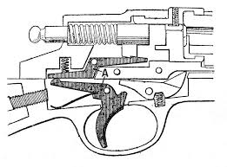
Trigger Restriction: –
Used to stop the activation of trigger based on condition. If condition is TRUE trigger is active.
www.provendwconsultant.com

Slide 117
Trigger types:-
Two types of Triggers are there
1. Row level trigger- Activates the trigger for every row manipulated by DML statement
2. Statement level trigger- Activates the trigger only one’s for one DML statement(default type).
www.provendwconsultant.com

Slide 118
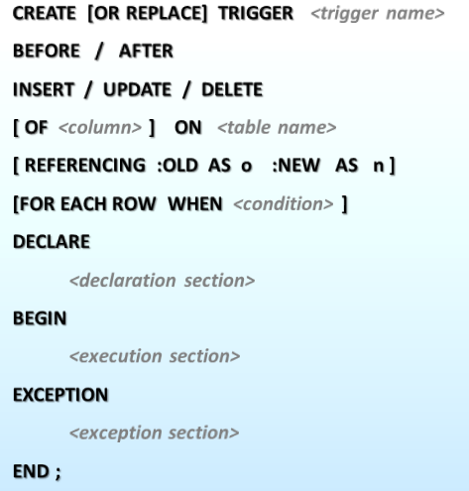
Trigger body: – A set of PL/SQL statements.
www.provendwconsultant.com

Slide 119
NEW and OLD (pseudo columns) :
Used to retrieve data from DML statement temporary buffer to trigger body
Valid with ROW level trigger only
This clause is used to reference the old and new values of the data being changed.
www.provendwconsultant.com

Slide 120
By default, you reference the values as: :old.column_name
or
: new.column_name.
The reference names can also be changed from old (or new) to any other user-defined name. You cannot
reference old values when inserting a record, or new values when deleting a record,because they do not exist.
www.provendwconsultant.com

Slide 121
ROW LEVEL TRIGGER
The trigger body executes once for each row affected by the triggering event.
A row level trigger is not executed if the triggering event affects no rows.
Row level triggers are useful if the trigger action depends on data of rows that are affected or on data provided by the triggering event itself.
www.provendwconsultant.com

Slide 122
Example:-
CREATE OR REPLACE TRIGGER up_ename
BEFORE INSERT
ON emp
FOR EACH ROW
BEGIN
:NEW.ename := UPPER (:NEW.ename);
END;
– Trigger created.
www.provendwconsultant.com

Slide 123
Now we are going to insert record into ‘emp’ table
INSERT INTO emp (empno, ename, sal, comm, deptno)
VALUES (7711, 'andrew',3500, 500, 10);
--inserted
SELECT * FROM emp WHERE empno=7711;
Output:-
7711 ANDREW 3500 500 10
www.provendwconsultant.com

Slide 124
STATEMENT LEVEL TRIGGER
Activates the trigger for only once for one DML statement.
A statement trigger is fired once on behalf of the triggering event, even if no rows are affected at all.
www.provendwconsultant.com

Slide 125
Example:-
CREATE OR REPLACE TRIGGER sec_emp
BEFORE INSERT ON emp
BEGIN
IF TO_CHAR (SYSDATE,'DY') in ('SAT','SUN') THEN
RAISE_APPLICATION_ERROR (-20101,'in week ends we can not insert record');
END IF;
END;
www.provendwconsultant.com

Slide 126
INSERT INTO
EMP(EMPNO, ENAME, DEPTNO) VALUES
(7913, ’mike’, 10);
Output:-
Error report: SQL Error: ORA-20101: in week ends we cannot insert record ORA-06512: at “APPS.SEC_EMP” ORA-04088: error during execution of trigger‘APPS.SEC_EMP’
www.provendwconsultant.com

Slide 127
Trigger Execution Hierarchy
PL/SQL Trigger Execution Hierarchy
The following is the sequence in which different triggers are fired.
Before statement level
Before row level
After row level
After statement level
www.provendwconsultant.com

Slide 128
Before statement level
BEFORE UPDATE STATEMENT LEVEL:
This trigger will insert a record into the table ‘test’ before a sql update
CREATE OR REPLACE TRIGGER emp_sal_upd_stmt_level_trig
BEFORE UPDATE ON emp
BEGIN
DBMS_OUTPUT.PUT_LINE('Updating employees ');
INSERT INTO test values('Stmt level Before update - Updating employees ');
END;
www.provendwconsultant.com

Slide 129
BEFORE UPDATE, ROW LEVEL:
2This trigger will insert a record into the table ‘test’ before each row is updated.
CREATE OR REPLACE TRIGGER emp_sal_upd_stmt_level_trig
BEFORE UPDATE ON emp
FOR EACH ROW
DECLARE
sal_diff NUMBER;
www.provendwconsultant.com

Slide 130
BEGIN
sal_diff := :NEW.sal - :OLD.sal;
DBMS_OUTPUT.PUT_LINE('Updating employee ' || :OLD.empno);
DBMS_OUTPUT.PUT_LINE('..Old salary: ' || :OLD.sal);
DBMS_OUTPUT.PUT_LINE('..New salary: ' || :NEW.sal);
DBMS_OUTPUT.PUT_LINE('..Raise : ' || sal_diff);
Insert into test values('Row level Before update - Updating employee ' || :OLD.empno);
END;
/
www.provendwconsultant.com

Slide 131
AFTER UPDATE, STATEMENT LEVEL:
CREATE or REPLACE TRIGGER emp_sal_aftr_upd_stmt_level_trig
AFTER UPDATE ON emp
BEGIN
DBMS_OUTPUT.PUT_LINE('Updating employees ');
INSERT INTO test values('Stmt level After update - Updating employees ');
END;
/
update statement is executed, at the statement level.
www.provendwconsultant.com

Slide 132
AFTER UPDATE, ROW LEVEL:
This trigger will insert a record into the table ‘product_check’ after each row is updated.
CREATE OR REPLACE TRIGGER emp_sal_aftr_upd_row_level_trig
AFTER UPDATE ON emp
FOR EACH ROW
DECLARE
sal_diff NUMBER;
www.provendwconsultant.com

Slide 133
BEGIN
sal_diff := :NEW.sal - :OLD.sal;
DBMS_OUTPUT.PUT_LINE('Updating employee ' || :OLD.empno);
DBMS_OUTPUT.PUT_LINE('..Old salary: ' || :OLD.sal);
DBMS_OUTPUT.PUT_LINE('..New salary: ' || :NEW.sal);
DBMS_OUTPUT.PUT_LINE('..Raise : ' || sal_diff);
INSERT INTO test values('Row level after update - Updating employee ' || :OLD.empno);
END;
/
www.provendwconsultant.com

Slide 134

Now lets execute a update statement on table emp.
UPDATE emp SET sal = 2000
WHERE deptno = 10;
Let’s check the data in test table to see the order in which the trigger is fired.
SELECT * FROM test;
www.provendwconsultant.com

Slide 135


Slide 136
.
THANKS & REGARDS
SRIKANTH KESHAVENA
www.provendwconsultant.com

